Slide 1
Covid-19 Fake News Detection Using Natural Language Processing
Sarah Mahmoud Bani Issa
Rua’a Yahia Eid
Under the guidance of
Dr. Abeer Hiary

Slide 2
Title of the project

Slide 3
Introduction
Notes:
Say what we will discuss in this section
the abstract -> the idea of the project
Importance-> why we chose this idea
Objectives->what is our goals from this whole project

Slide 4
Abstract
This project is about analyzing collected data about both fake and real news related to covid-19 virus and feed it to three machine learning classifiers.
Notes:
What is the idea?
Clarify that the project is 2 sections {data analysis , machine learning algorithms}

Slide 5
Importance
False information costs lives
According to BBC news: Hundreds dead because of Covid-19 misinformation.
Knowing the inner structure of fake news can help identifying it earlier.
Notes:
Exploring Hidden structure in the data.

Slide 6
Objectives
Find the patterns of both fake and real news.
Predict whether given news is fake or real.
Notes:
Goals of our project:
1- using data analysis tools
2-with use of machine learning classifiers

Slide 7
Data
The data was taken from a previous similar project, with a size of 41 KB, 73 record.

Slide 8
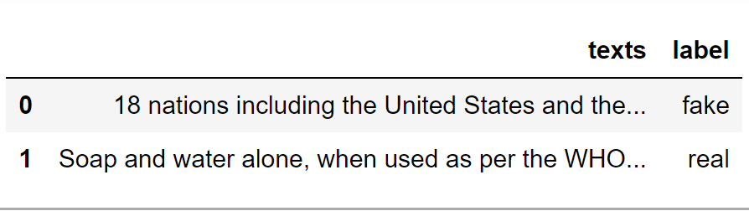
Data before cleaning
Data after cleaning
Notes:
Here we cleaned the data, as shown it now lower case and free of:
Duplication/ numbers/ stop words/ punctuation marks!

Slide 9
Methodology and Results
Data analysis*
Notes:
How we implemented the project?
We will discuss :
What 3 data analysis techniques we used in this project
What 3 Machine Learning Algorithms we have used
Display the Flowcharts for each part

Slide 10
Data Analysis
Here is a simplified Flowchart:
Get the data
Clean it
Applying the three techniques
Word cloud
Data sentiment
Topic modeling
False
See
If it makes sense
True
Compare the results
Notes:
Word cloud: A composed word image, to visually represent most frequented words texts, where most repeated shown in bigger and bolder font.
#Word sentiment:
give an example about knowing whether the feedbacks from customers are positive or negative about a certain product or service!
*Polarity: How positive or negative a word is, in range of [-1, 1] where -1 is negative and 1 is positive.
*Subjectivity How subjective, or opinionated a word is. 0 is fact. +1 is very much an opinion.
#Topic modeling: The goal of topic modeling is to find various hidden topics that are present in the data

Slide 11
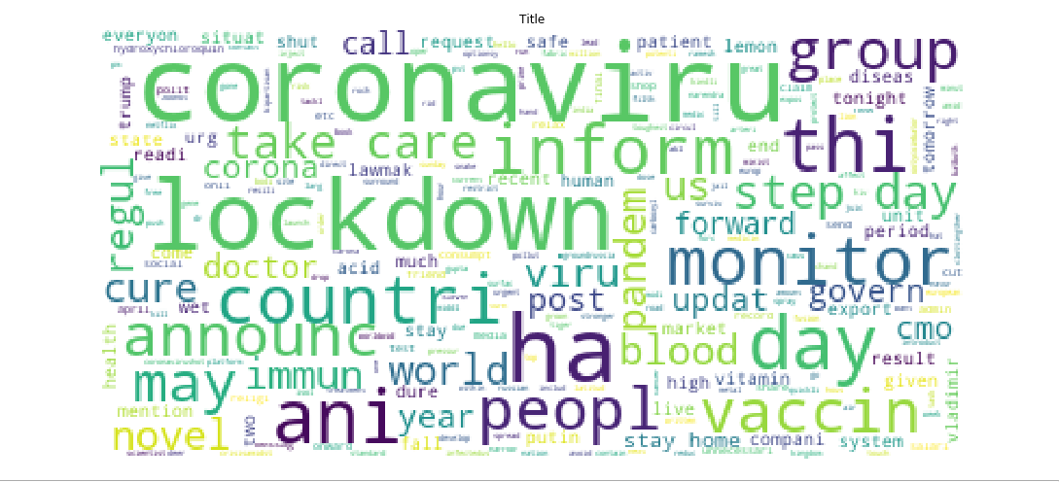
Word cloud Fake news
Notes:
Here we can see most frequented words in fake news, as it shown
Fake news usually interested in the lockdown/ pandemic/ immune system and vaccines!

Slide 12
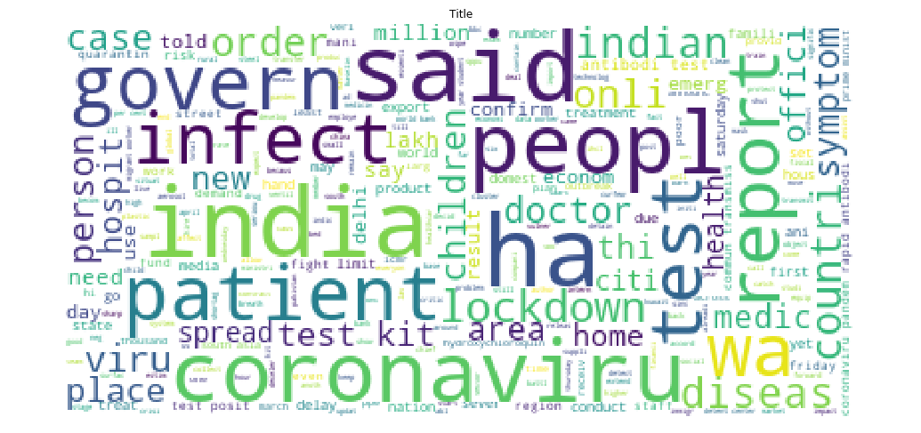
Word cloud Real news
Notes:
Whereas real news usually contains words like
infection/ patients/ spread/ diseases/ children/ symptoms and reports!

Slide 13
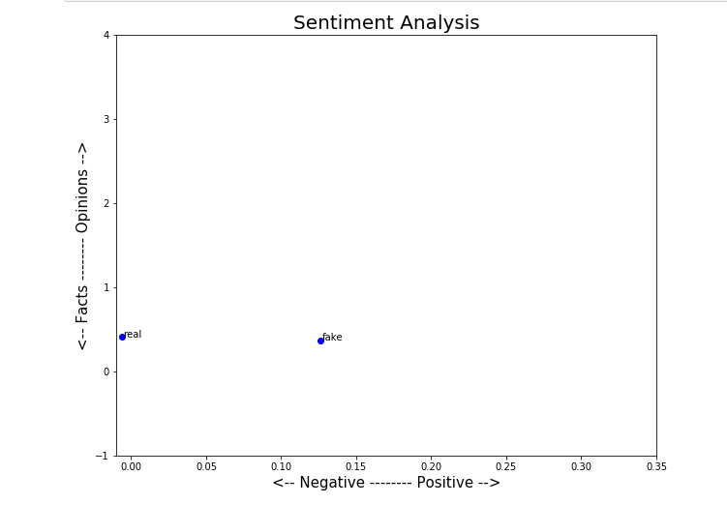
Data sentiment for both fake and real news:
Notes:
As shown in figure, in polarity,, fake news tends to be more positive than real news about the virus
But when it comes to subjectivity both tends to subjective [facts] news, it’s reasonable because both news were written in formal language, which led the algorithm to not be able to distinguish any differences.

Slide 14
Topic modeling
Two topics were extracted from the data corpus:
Then we wanted to figure out which topic was contained by each label, the results were as following:
 | Most repeated words | Topic overview
Topic 0 | Infect- kit symptom- person- hospit- bank- posit-south-case | Infections, hospitals, symptoms
Topic 1 | Monitor - care- vaccine -corona-record-fall-immune-unnecessary | Vaccine ,care, immuney system
Real news | Fake news
Topic 0 | Topic 1
Notes:
We first tried (the corpus data as it is) and the results were quite blurring
Then we tried to include (only nouns) in the process, it gave us a good results
But we thought we can do better,, when we include (adjectives and nouns),, which gave us a much better results!

Slide 15
Methodology and Results
Machine learning algorithms*
Notes:
In this section we will have a small brief about each machine learning algorithm

Slide 16
Machine Learning Algorithms
Here is a simplified Flowchart:
Get the data
Preprocess the data
Preform three algorithms
Logistic regression
Multinomial NB
Support vector machine
False
Test it
True
Compare the results

Slide 17
Logistic Regression
Accuracy score : 66.6%
Confusion matrix :
Predicted Fake | Predicted Real
5 | 2 | Actual Real
8 | 0 | Actual Fake
Notes:
Mention that without any data cleaning the accuracy score was 46%, with cleaning it increases up to 66%
logistic regression is a classifier for dependent features
can have different decision boundaries , with different weights that are near the optimal point.

Slide 18
Support Vector Machine and Multinomial Naïve Bayes
Accuracy score: 73.3%
Confusion matrix:
Predicted Fake | Predicted Real
3 | 4 | Actual Real
7 | 1 | Actual Fake
Notes:
Support vector machine is a supervised classifier
tries to finds the “best” margin (distance between the line and the support vectors) that separates the classes, and this reduces the risk of error on the data
Kernel = linear

Slide 19
Conclusions
After testing and comparing, now its time for some conclusions*

Slide 20
The following remarks can be concluded after finishing this project:
Both word cloud and topic modeling are suitable for analyzing news data.
Both multinomial NB and Support vector machine algorithms are acceptable, while logistic regression showed lower results.

Slide 21
Future Work
Expand the data.
Try other data analysis techniques.
Try other machine learning classifiers.

